Slide 1


Slide 2
Intel® Unnati Industrial Training 2025
PROJECT
Enhancing Customer Experience with AI-Driven Insights
(PIYAS BANERJEE)

Slide 3
Objective-
Detect and identify customers using face recognition.
Enable customers to speak the keyword "update".
Automatically fetch and display their stored details.
All done offline using optimized models.

Slide 4
System Overview-
Real-time face detection and recognition using OpenVINO.
Voice command detection using Vosk (offline speech recognition).
Displays customer data instantly upon command.

Slide 5
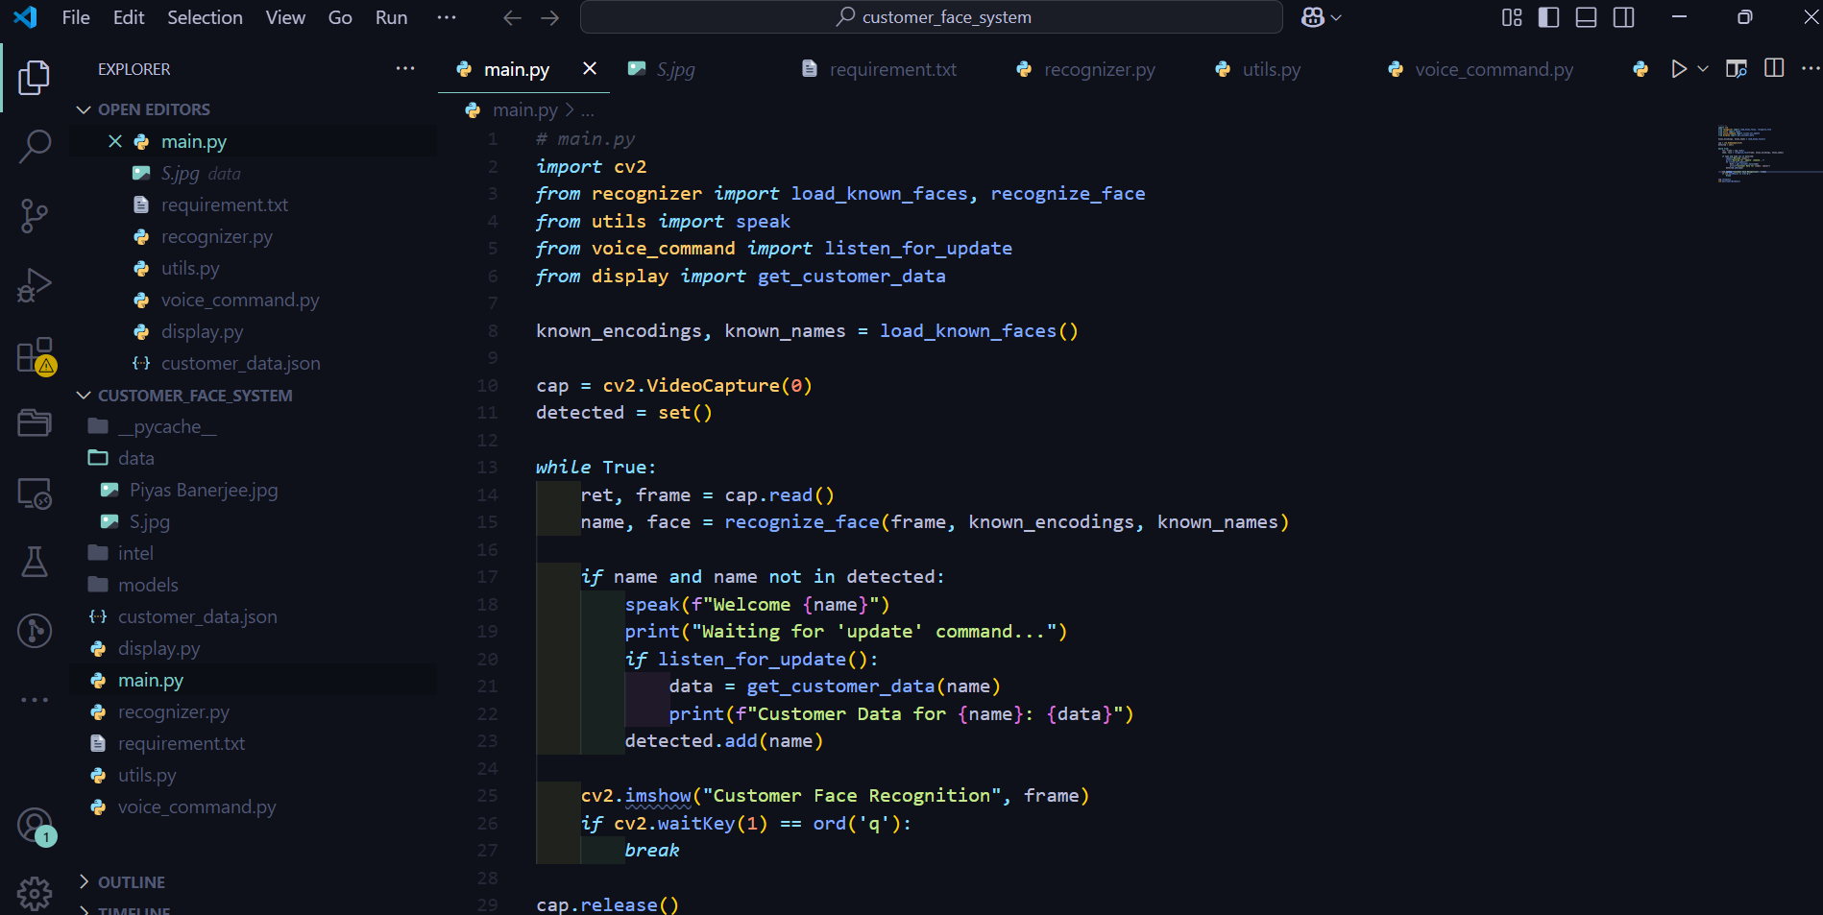
Customer Face Detection and Voice-Activated Data Update

Slide 6
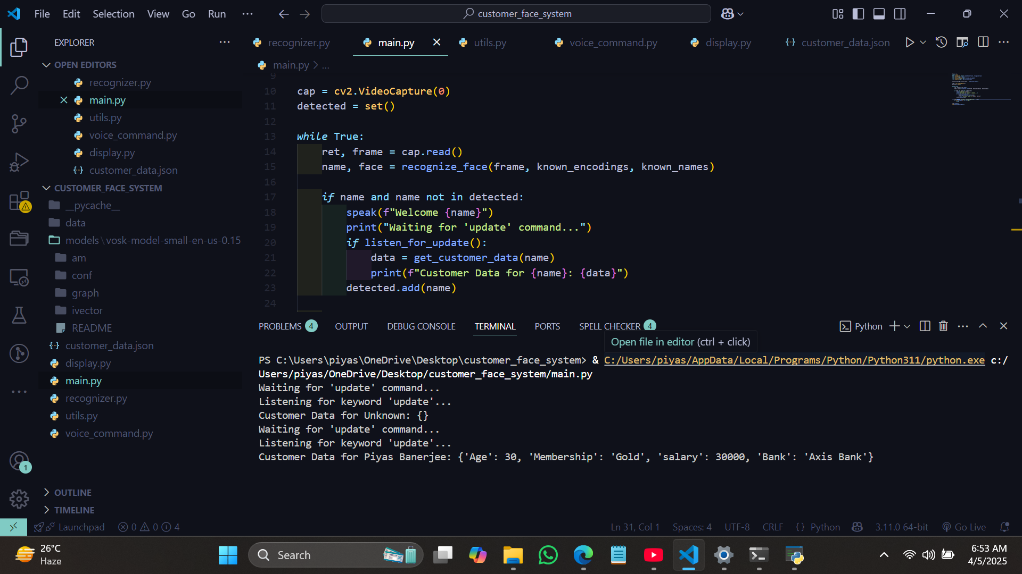

Slide 7
